Slide 1
WEEK 16
Analysis of Variance (ANOVA)
One–Way ANOVA

Slide 2
After learning this topic students are expected to:
state the hypotheses;
run the test using Excel;
be able to manually fill in the table when some parts of ANOVA are missing;
identify degrees of freedom;
interpret the test results.

Slide 3
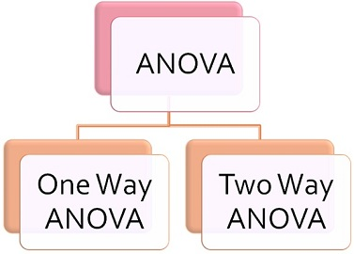
Analysis of Variance (ANOVA)
One–Way ANOVA
ANOVA is a statistical procedure used to test the degree to which two or more groups vary or differ in an experiment.

Slide 4
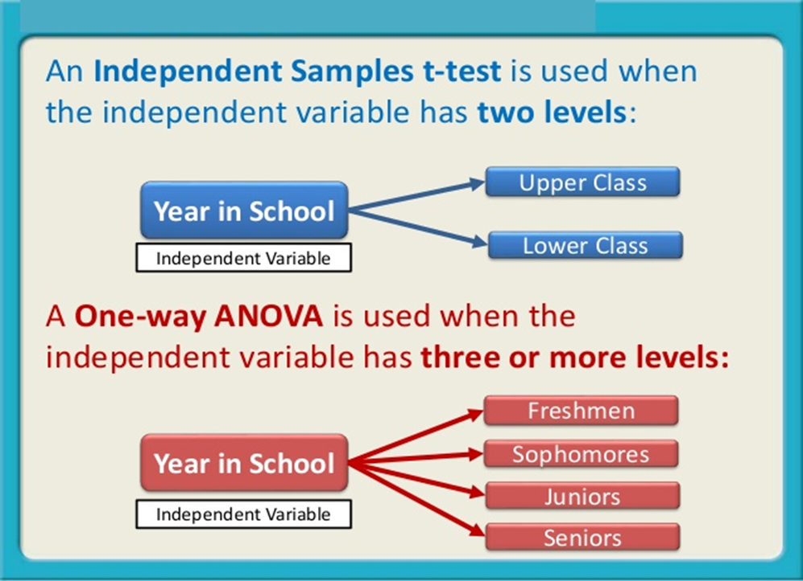
One-Way ANOVA
A One-Way ANOVA is a type of statistical test that compares the variance in the group means within a sample whilst considering only one independent variable or factor.
This is an extension of the two independent samples t-test

Slide 5
One–Way ANOVA
The null hypothesis is that the means are all equal:
  H₀: µ₁ = µ₂ = µ₃ = …µ_{k}
The alternative hypothesis is that at least one of the means is different.
  H_{a}: At least one mean is different.

Slide 6
One–Way ANOVA
The assumptions necessary to ensure the validity of the test are as follows:
The samples are selected randomly and independently.
The probability distributions for each factor level are normal.
The variances of each population are assumed equal.

Slide 7
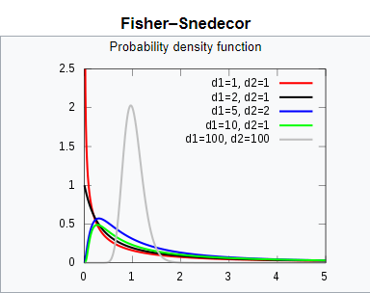
F-Distribution

Slide 8
One–Way ANOVA
Rejection Region:
Reject H₀ if F_{stat} ≥ F_{crit}
F_{stat} = MSF/MSE
MSF – Mean Square for
Factor
MSE – Mean Square for
Error
F_{crit} can be obtained
from F table for α with:
df₁ = k-1 ( k - number of groups)
df₂ = n-k (n – total number
of observations for all groups)

Slide 9
One–Way ANOVA
Example
The statistics classroom is divided into three rows: front, middle, and back.
The instructor noticed that the further the students were from him, the more likely they were not listening to him or use Telegram during class.
He wanted to see if the students further away did worse on the exams.

Slide 10
One–Way ANOVA
The ANOVA doesn’t test that one mean is less (more) than another, only whether they’re all equal or at least one is different.
  H₀: µ_{F} = µ_{M} = µ_{B}
H_{a}: At least one mean score is different.

Slide 11
One–Way ANOVA
A random sample of the students in each row was taken.
The scores for those students on the midterm exam was recorded:
  Front: 82, 83, 97, 93, 55, 67, 53
  Middle: 83, 78, 68, 61, 77, 54, 69, 51, 63
  Back: 38, 59, 55, 66, 45, 52, 52, 61

Slide 12
One–Way ANOVA
The summary statistics for the grades of each row are shown in the table below:
 | Front | Middle | Back
Sample Size | 7 | 9 | 8
Mean | 75.71 | 67.11 | 53.5
St. Deviation | 17.63 | 10.95 | 8.96
Variance | 310.9 | 119.86 | 80.29

Slide 13
One–Way ANOVA
There are two sources of variation:
  the variation between the groups, SS(B), or the variation due to the factor, SS(F).
  the variation within the groups, SS(W), or the variation that can’t be explained by the factor so it’s called the error variation, SS(E).

Slide 14
One–Way ANOVA
Here is the basic one-way ANOVA table:
Source of Variation | Sum of Squares | Degrees of Freedom | Mean Square | F
Factor (Between) | SSF | k-1 | MSF= SSF/k-1 | MSF/MSE
Error (Within) | SSE | n-k | MSE= SSE/n-k
Total | SST | n-1

Slide 15
One–Way ANOVA
=F.DIST.RT(5.896, 2, 21)
Excel output:
Source of Variation | SS | df | MS | F | P-value | F crit
Between Groups | 1901.52 | 2 | 950.76 | 5.896 | 0.0093 | 3.467
Within Groups | 3386.32 | 21 | 161.25
Total | 5287.83 | 23
Excel function =F.INV(0.95,2,21)

Slide 16
One–Way ANOVA
At α = 0.05, since F ≥ F_{crit}, we reject null hypothesis and conclude that at least one of the mean grades among three rows (front, middle, back) is different than the rest.

Slide 17
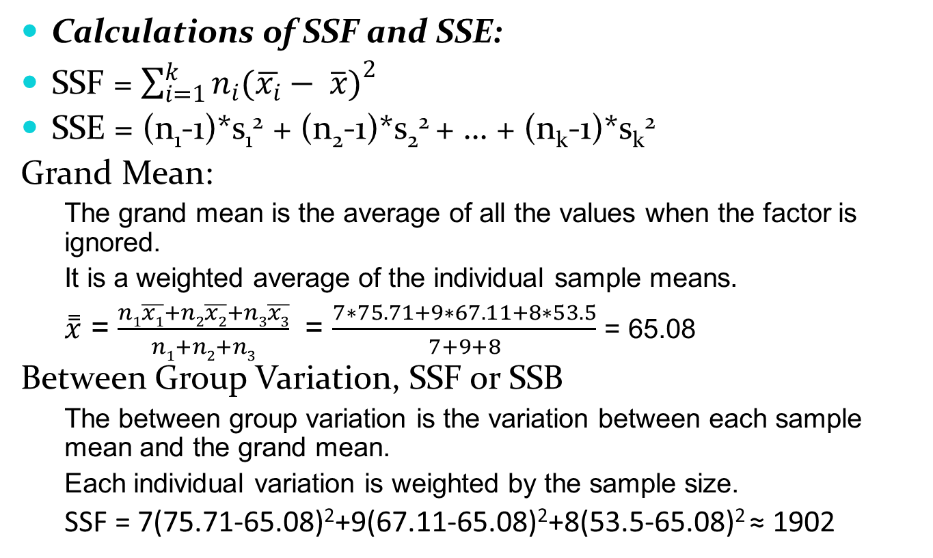
One–Way ANOVA (Optional)
Calculations of SSF and SSE:
SSF = $\sum_{i=1}^{k}{n_{i}(\overline{x_{i}}− \overline{x}})^{2}$
SSE = (n₁-1)*s₁² + (n₂-1)*s₂² + … + (n_{k}-1)*s_{k}²
Grand Mean:
  The grand mean is the average of all the values when the factor is ignored.
  It is a weighted average of the individual sample means.
  $\overset{̿}{x}$ = $\frac{n1\overline{x1}+n2\overline{x2}+n3\overline{x3}}{n1+n2+n3}$ = $\frac{7∗75.71+9∗67.11+8∗53.5}{7+9+8}$ = 65.08
Between Group Variation, SSF or SSB
  The between group variation is the variation between each sample mean and the grand mean.
  Each individual variation is weighted by the sample size.
  SSF = 7(75.71-65.08)²+9(67.11-65.08)²+8(53.5-65.08)² ≈ 1902

Slide 18
One–Way ANOVA (Optional)
Within Group Variation, SSE or SSW
  The Within Group Variation is the weighted total of the individual variations.
  The weighting is done with the degrees of freedom.
  The df for each sample is one less than the sample size for that sample.
SSE = 6*310.9 + 8*119.86 + 7*80.29 ≈ 3386
SST = SSF + SSE = 1902 + 3386 = 5288

Slide 19
Literature
A. Holmes; B. Illowsky; S. Dean. Introductory Business Statistics. Chapter 12.
Anova in Excel
https://www.excel-easy.com/examples/anova.html

